Slide 1
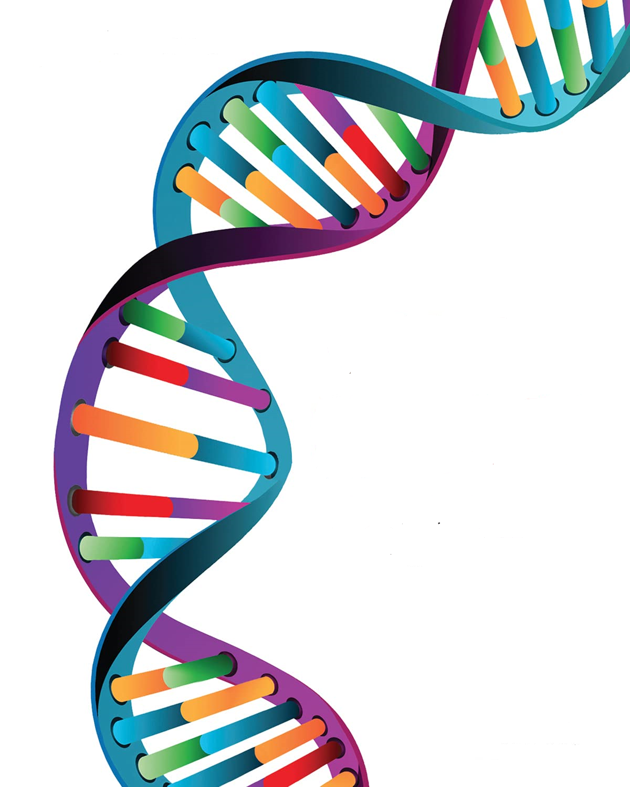
Classification of Highly Interacting Regions of the Genome with Explainable AI
Group: 36
External Guide: Dr. Leelavati Narlikar, IISER Pune
Mentor: Miss. Anushua Biswas, IISER Pune
Internal Guide: Mrs. Pranjali Deshpande
Radhika Sethi - 4456
Shreya Pawaskar - 4947
Aanchal Tulsiani - 4964

Slide 2
RoadMap
Problem Statement
Objectives
Designed Methodology
Requirements
Dataset generation
Data Flow Diagrams
Activity Diagram
Higher Order Markov Models on Dummy Data
Cross Validation of Statistical Models.
Why is Deep Learning Important in genomics.
CNN Model Architecture
CNN Results & Cross Validation
What is Explainable AI
Future Work, Conclusions, Accomplishments, References.

Slide 3
Introduction
Current Scenario
What we wish to achieve
Symptom-driven approach towards treatment
SARS-CoV-2 and it’s mutations were not sequenced until recently
Treating the symptom instead of uncovering the infection
Early disease diagnosis and control efforts
Mitigation strategies through genomic epidemiology
Predictive modelling
Notes:
Coronavirus existed long before it started to infect humans.
Once it did affect people, the first approach was to treat the symptoms, and later researchers looked into the virus, it’s genome and it’s mutations to find answers at the very source of it
Why did coronavirus affect individuals differently? A study found out that Severe responses to coronavirus infection could be caused by genetic differences between individuals.
It has a high mutation rate
The study of SARS-CoV-2 whole genome sequencing (WGS) data has led to many important findings about this pathogen, and we will need more sequence data from samples from all over the world in order to come up with effective approaches to control and prevent COVID-19 infections. Scientists from across the globe are collaborating to generate and share this invaluable information and apply it to disease diagnosis and control efforts.
Genomic epidemiology is defined as the use of genomic sequence data to understand infectious disease transmission and population dynamics. Whole genome sequencing provides the most high-resolution data, and allows for the efficient relatedness analysis that is instrumental to outbreak investigations at all levels, ranging from within a community to intercontinental spread during a pandemic. A study published in the New England Journal of Medicine used SARS-CoV-2 genomic epidemiology to guide the investigation of an outbreak within a skilled nursing facility. Investigators were able to determine relatedness between different SARS-CoV-2 virus sequences from various patients, concluding that pre-symptomatic patients most likely contributed to transmission.

Slide 4
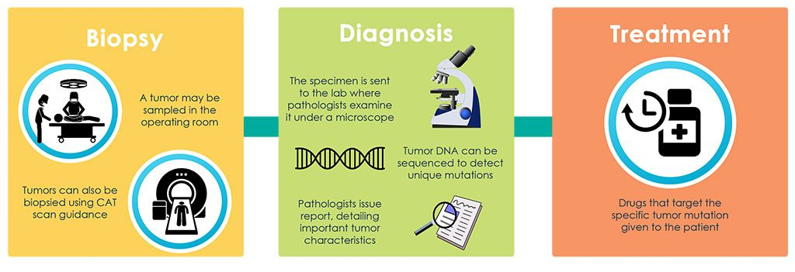
Introduction
Introduction
Precision Medicine
An emerging approach for disease treatment and prevention
Developing genetically targeted therapies based on large populations of data.
Previously:
Notes:
But all of this comes under the wide umbrella of “precision medicine”
Precision medicine is an approach to medical care in which disease prevention, diagnosis, and treatment are tailored to the genes, proteins, and other substances in your body.

Slide 5
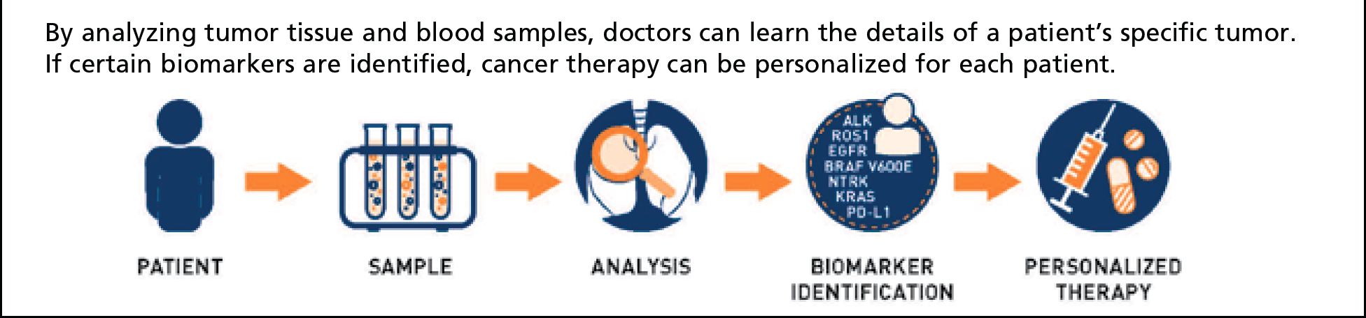
Introduction
Introduction
Precision Medicine
Now: Biomarker testing for cancer treatment
Notes:
Now we are edging towards biomarker testing for cancer and other genetic diseases
Cancer is a genetic disease—that is, cancer is caused by certain changes to genes that control the way our cells function, especially how they grow and divide. Genes carry the instructions to make proteins, which do much of the work in our cells.I
Biomarker testing is a way to look for regions in the genome, proteins, and other substances (called biomarkers or tumor markers) that can provide information about cancer. Each person’s cancer has a unique pattern of biomarkers. Some biomarkers affect how certain cancer treatments work. Biomarker testing may helpthe doctor choose a cancer treatment for the patient
Biomarker testing for cancer treatment may also be called as genomic testing or genomic profiling. How is it done? Liquid biopsy by drawing blood. Blood samples are tested in the lab for biomarkers.
For some biomarker tests that analyze genes, you will also need to give a sample of your healthy cells. This is usually done by collecting your blood, saliva, or a small piece of your skin. These tests compare your cancer cells with your healthy cells to find genetic changes (called somatic mutations) that arose during your lifetime. - and this is what our work is focused on
Biomarker testing helps in 2 ways -
For example, people with cancer that has certain genetic changes in the EGFR gene can get treatments that target those changes, called EGFR inhibitors. In this case, biomarker testing can find out whether someone’s cancer has an EGFR gene change that can be treated with an EGFR inhibitor.
Biomarker testing could also help you find a study of a new cancer treatment (a clinical trial) that you may be able to join. Some studies enroll people based on the biomarkers in their cancer, instead of where in the body the cancer started growing. These are sometimes called basket trials.
The idea of precision medicine isn’t new, but recent advances in science and technology have helped speed up the pace of this area of research. Scientists now understand that cancer cells can have many different changes in genes, proteins, and other substances that make the cells grow and spread. They have also learned that even two people with the same type of cancer may not have the same changes in their cancer. Some of these changes affect how certain cancer treatments work.

Slide 6
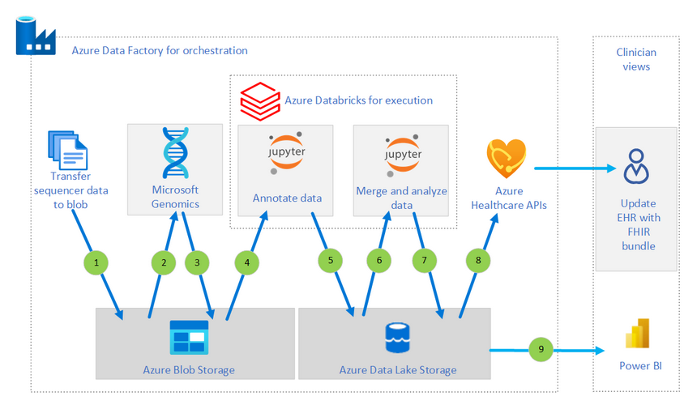
Introduction
Precision Medicine Pipeline
Workflow:
Taking data from a sequencer
Moving the data through secondary analysis
Providing results that clinicians can consume
Potential Use Cases:
Risk scoring for patients with genetic diseases
Identifying patients with genetic markers that make them prone to disease
Generating patient cohorts for studies

Slide 7
Introduction
Limitations of Precision Medicine Pipeline
Limitations of Precision Medicine:
Too complex and not widely known
Expensive
Inaccessible to underserved populations
Example - Most data comes from caucasian DNA
Hard to find a place for it in primary care
Focused on
Bioinformatics
biological experiments
next generation sequencing methods
Notes:
Lacks the use of deep learning, allowing earlier interventions using advanced diagnostics and tailoring better and economically personalized treatments.

Slide 8
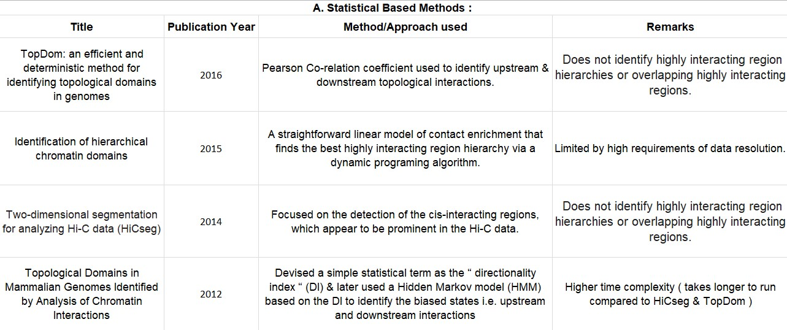
Literature Review
Notes:
And using these as a motivation, we will present our literature survey that is focused on being able to identify highly interacting regions in the genome , only once we know what are the highly interacting regions and proteins that are interactng, can we provide further information on the cause of the disease

Slide 9
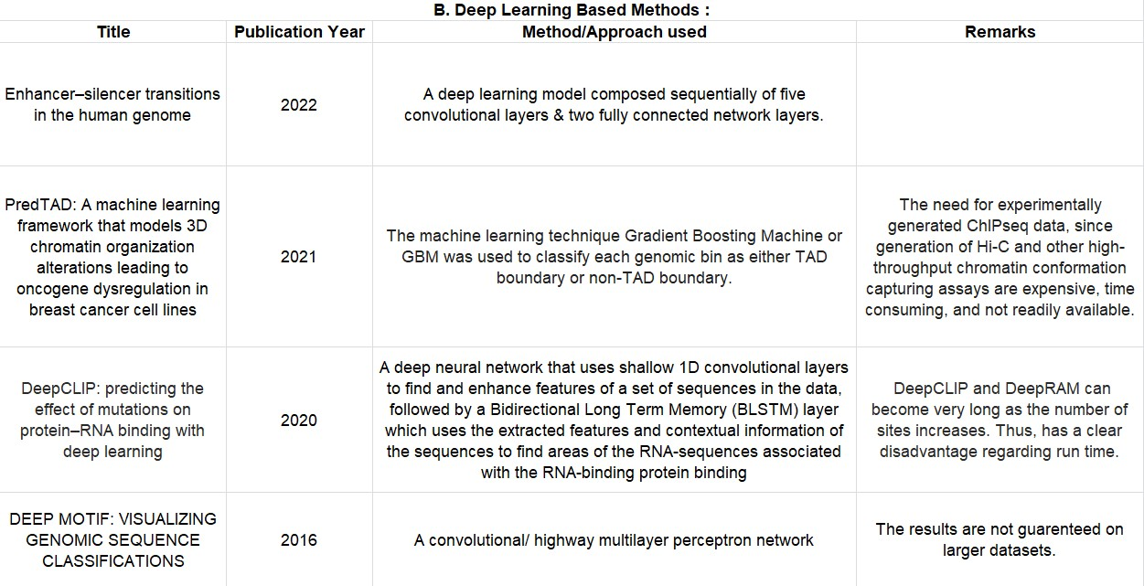
Literature Review

Slide 10
Motivation
To have an efficient system, which is also consistent across all kinds and sizes of datasets, with minimum computation time.
To explore genomic sequences at boundaries of the highly interacting regions.
To understand WHY is the region being classified as highly interacting?
To understand what caused the region to be a highly interacting one.
To build a generalized pipeline based on all these objectives and understand what causes gene regulation
Notes:
The process of turning genes on and off is known as gene regulation. Gene regulation is an important part of normal development. Genes are turned on and off in different patterns during development to make a brain cell look and act different from a liver cell or a muscle cell

Slide 11
Problem Statement
“Identify regions governing gene regulation and classify them into highly interacting and non interacting regions with Explainable AI”.

Slide 12
Objectives
The Objectives being covered are :
Learn how to model biological sequencing and DNA data. Understand their underlying properties and how to find patterns in them
Efficiently use deep learning algorithms to distinguish between highly interacting and non interacting regions
Find which traits of highly interacting regions make them more interactive.
Understand how these specific regions influence gene regulation.
Find genomic sequence properties which influence the transformation of a cell into a diseased cell.
Notes:
The process of turning genes on and off is known as gene regulation. Gene regulation is an important part of normal development. Genes are turned on and off in different patterns during development to make a brain cell look and act different from a liver cell or a muscle cell

Slide 13
Designed Methodology
Input
Processing
XAI
Results
Any virus genome / diseased organisms genome
The pipeline processes the regions into highly interacting and non interacting regions
Provide personalized medication to the population
To understand the critical parts of the DNA

Slide 14
Markov model Proposed architecture
Markov Model designed Architecture
Genomic Data Input
Data Processing
Markov Models
Results and Visualizations

Slide 15
CNN Proposed architecture
Deep Learning designed Architecture
Genomic Data Input
Data Processing
CNN
XAI
Results and Visualizations

Slide 16



Requirements
Technical Requirements:
Google Colab
Bioinformatics Tools
NCBI databases
Python - Sklearn, Pandas, Seaborn, etc.
Hardware required:
GPU access for training models
Linux Kernel for bioinformatics tools (BED Tools)
Intel i3 or higher
4GB RAM
1 Gb hard free drive space

Slide 17
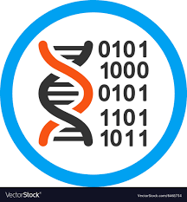
Dummy Data Generation
Genome characteristic = ‘GCCTCAGGCG’
Generated 2 such datasets
Chose a particular section of the human genome
25% probability of ACGT without any unique characteristic
25% probability of ACGT + a unique version of the characteristic
Notes:
25% probvability of ACGT + a unique version of the characteristic

Slide 18
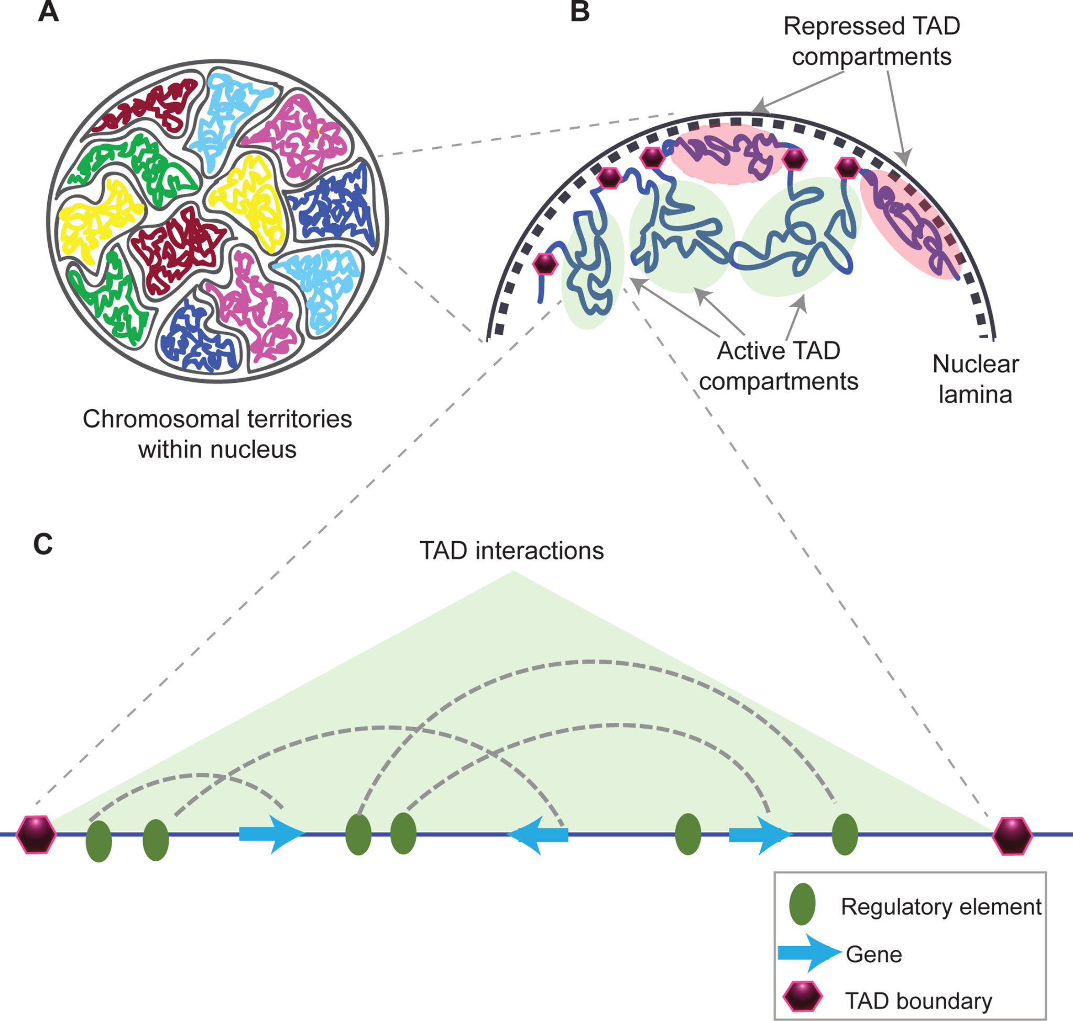
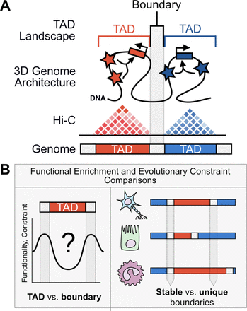
Real data generation
The dataset needed should tell us where the interactions take place in a genome.
The Hi-C data tell us about the genomes and coordinates where interactions take place.
After getting the coordinates data, we created the genome sequences of ACGT by the coordinates using the bioinformatics tools.
After the data was ready, we took two parts:
The regions with high interactions
The regions far away with lesser interaction.
This was done to understand the difference between these two regions.
The data was converted in a .txt format suitable for the Markov models and the Deep Learning Models.
Notes:
The dataset needed should tell us where the interactions take place in a genome.
The Hi-C data tell us about the genomes and coordinates where interactions take place.
After getting the coordinates data, we created the genome sequences of ACGT by the coordinates using the bioinformatics tools.
After the data was ready, we took two parts:
The regions with high interactions
The regions far away with lesser interaction.
This was done to understand the difference between these two regions.
The data was converted in a .txt format suitable for the Markov models and the Deep Learning Models.

Slide 19
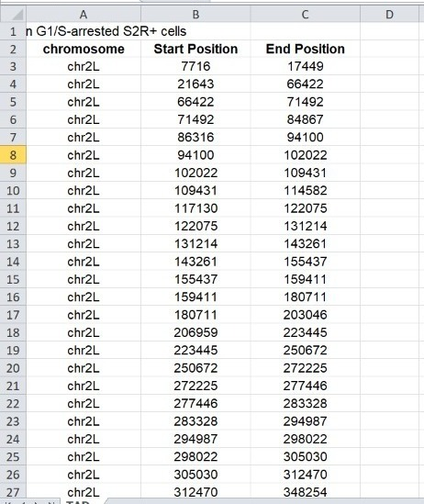
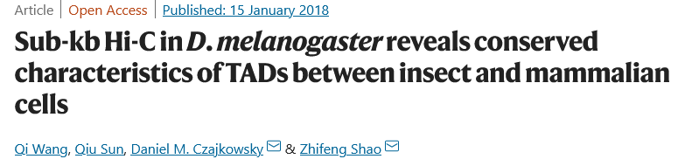
Accession number: GSE101317
Link: https://www.nature.com/articles/s41467-017-02526-9
NCBI -> downloaded the files with domain coordinates

Slide 20
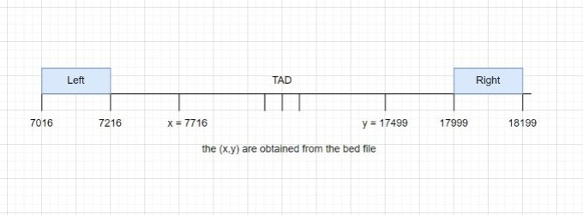
Shift of 500
Notes:
To get the coordinates of the left and right boundaries, we take a shift of 500 coordinates and generate 3 files accordingly.
Sequence length of 200 char
After generating the right bed files, we used 2BitToFa to generate it’s fasta file, and then converted the fasta file into a suitable database for our processing

Slide 21
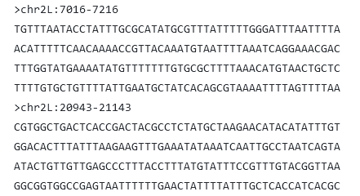
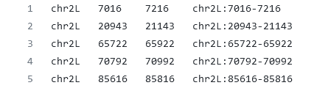
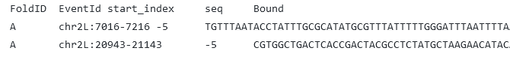
Shift of 500
1. Bed file
2. Fasta file
3. Textfile for models

Slide 22
Data flow Diagram
Higher Order Markov Models
Deep Learning - CNN architecture
Genome coordinate data (<1MB)
INPUT
CLASSIFICATION
EXPLAINABLE AI
Accuracy
AUC RoC Curve
Precision Recall Curve
Confusion Matrix
To backtrack and answer “WHY”
OUTPUT
DATA
VISUALIZATION

Slide 23
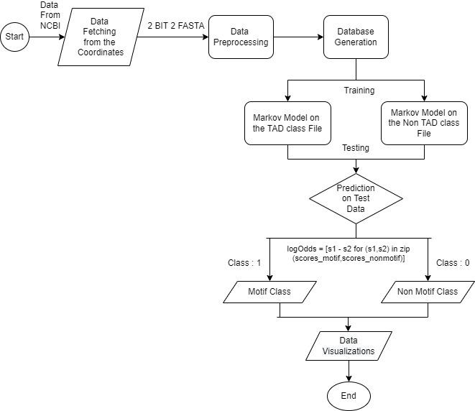
Activity Diagram for markov models
Notes:
Givr the hyperlink

Slide 24
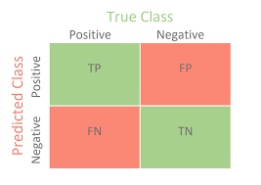
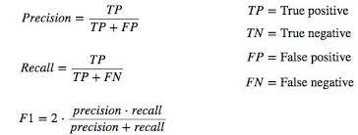
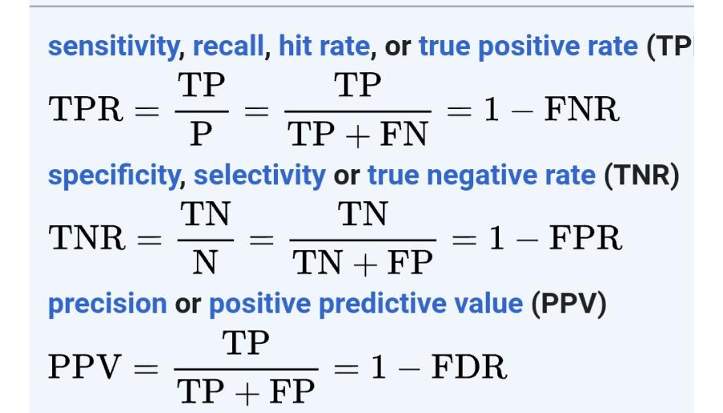
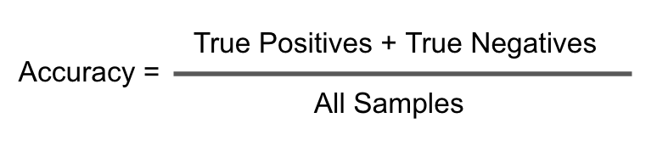
Metrics for Classification
Accuracy: sklearn.metrics.accuracy_score
Confusion Matrix: sklearn.metrics.confusion_matrix
AUC ROC: sklearn.metrics.roc_auc_score
F1 score: sklearn.metrics.f1_score

Slide 25
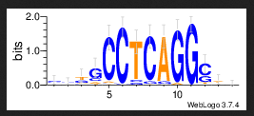
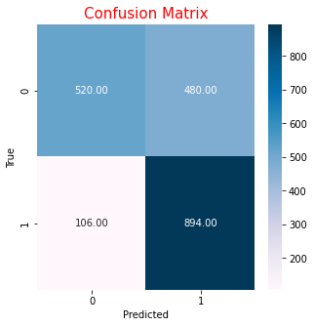
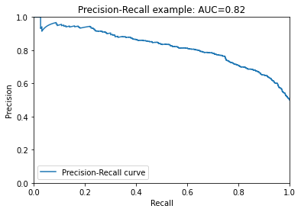
MA0003.4. - JASPAR
(Human Genome)
HMMs on Dummy Data
FoldID EventID start_index ... Bound predicted log odd score
0 A seq_986_peak -5 ... 0 0 -36.508978
1 A seq_902_peak -5 ... 0 0 -5.136077
2 A seq_963_peak 267 ... 1 1 66.917289
3 A seq_361_peak -5 ... 0 1 17.650922
4 A seq_487_peak -5 ... 0 0 -5.649734
... ... ... ... ... ... ... ...
1995 A seq_309_peak -5 ... 0 0 -5.455076
1996 A seq_960_peak -5 ... 0 0 -19.066406
1997 A seq_196_peak 49 ... 1 0 -3.408055
1998 A seq_756_peak 103 ... 1 1 14.057043
1999 A seq_86_peak -5 ... 0 0 -5.472158
Area Under Curve - 0.82
Accuracy - 0.71
Highest Accuracy for 12th Order Model

Slide 26
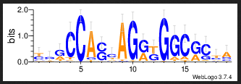

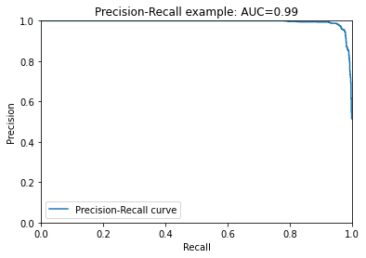
MA0139.1 - JASPAR
HMMs on Dummy Data
Step: 13
FoldID EventID start_index ... Bound predicted log odd score
0 A seq_392_peak 65 ... 1 1 28.419112
1 A seq_310_peak -5 ... 0 0 -6.635404
2 A seq_779_peak -5 ... 0 0 -4.868262
3 A seq_468_peak -5 ... 0 1 10.800039
4 A seq_648_peak 38 ... 1 1 33.041807
... ... ... ... ... ... ... ...
1995 A seq_627_peak -5 ... 0 0 -14.199399
1996 A seq_82_peak -5 ... 0 0 -8.730004
1997 A seq_990_peak 73 ... 1 1 27.079548
1998 A seq_29_peak 93 ... 1 1 10.662202
1999 A seq_840_peak -5 ... 0 1 10.074845
[2000 rows x 7 columns]
0.756
Area Under Curve - 0.99
Accuracy - 0.756
Highest Accuracy for 13th Order Model

Slide 27
Flow Diagram with Cross Validation
Start
For num of the k folds
Training
Markov Model with characteristic
Markov Model without characteristic
Combined Testing
Predicting the class using the log odd score
logOdds = [s1 - s2 for (s1,s2) in zip (scores_char,scores_nonchar)]
Characteristic Class
Non characteristic Class

Slide 28
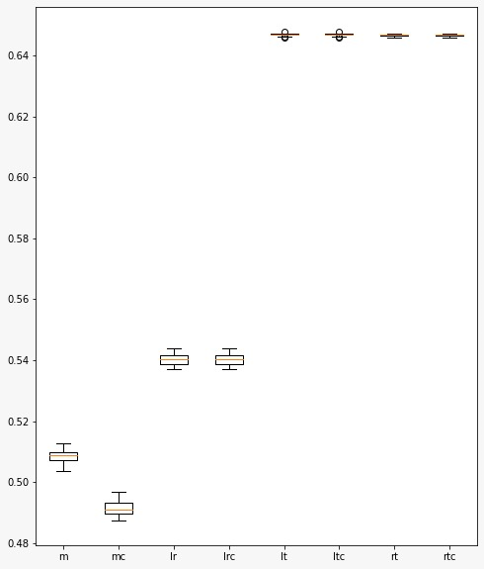
Box plot of ROC:
m - mixing the left and right datasets, dividing them into 2, and training separately.
mc - the same, but while also taking the complement of the sequences while training
lr - classification between left and right boundary
lrc - classification between left and right boundary (including their complements while training)
lt - classification between left and tad region
ltc - classification between left and tad region (including their complements while training)

Slide 29
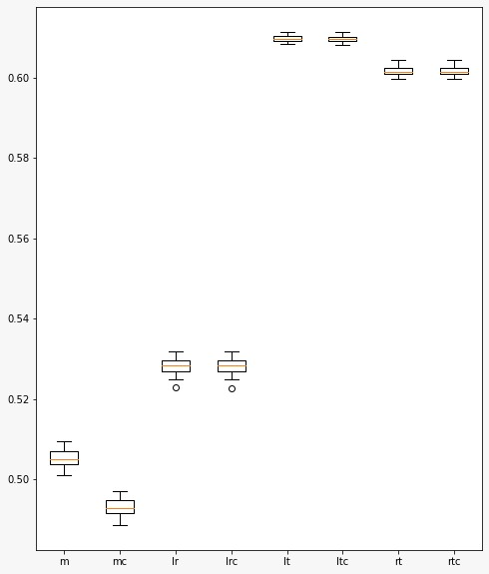
Box plot of ACC:
m - mixing the left and right datasets, dividing them into 2, and training separately.
mc - the same, but while also taking the complement of the sequences while training
lr - classification between left and right boundary
lrc - classification between left and right boundary (including their complements while training)
lt - classification between left and tad region
ltc - classification between left and tad region (including their complements while training)

Slide 30
Why is Deep Learning important in Genomics?
Deep Learning methods are capable of working on large datasets.
Capable of identifying highly complex patterns.
Can be used for the interpretation of regulatory control.
Can build generative models (generating their own data and feeding to the model)
Why a Convolutional Neural Network Architecture?
CNN’s can discover new patterns even when the locations of patterns within sequences are unknown
Can learn from millions of sequences through parallel implementation on a GPU
It generalizes well across technologies, even without correcting for technology-specific biases
It can tolerate a moderate degree of noise and mislabeled training data

Slide 31
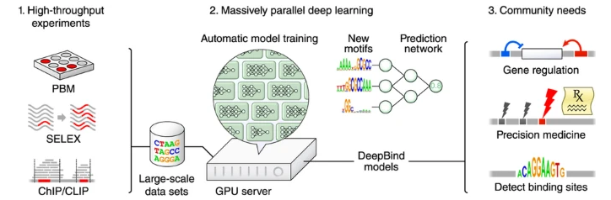
Why is Deep Learning important in Genomics?

Slide 32
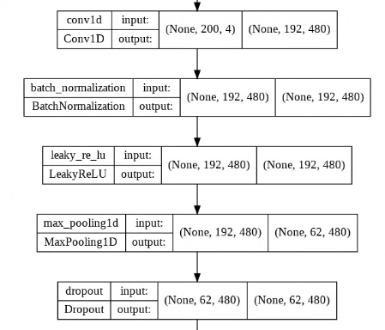
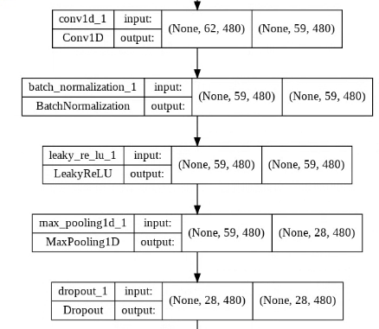
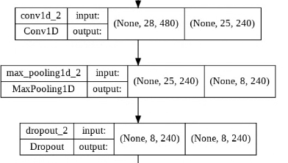
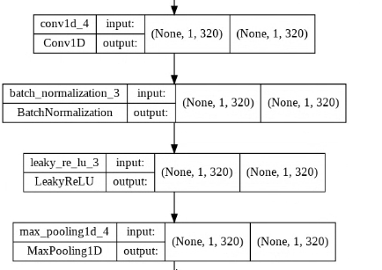
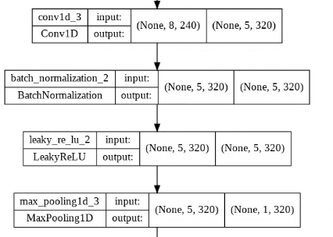
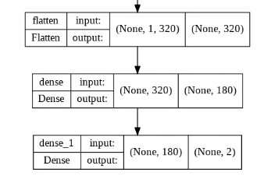
CNN Model Architecture

Slide 33
Results
Model | Val Acc | Test Acc | Trainable parameters | Layers Deleted
Original | 0.59 | 0.65 | 1,872,462
1 layer reduction (removed 4th set) | 0.6925 | 0.7818 | 1,653,902
None

Slide 34
Results
Model | Val Acc | Test Acc | Trainable parameters | Layers Deleted
2 layers reduction (removed 3rd and 4th set) | 0.7077 | 0.7975 | 1,675,422
3 layers reduction (removed 3rd, 4th and 5th set) | 0.5027 | 0.5563 | 5,376,062

Slide 35
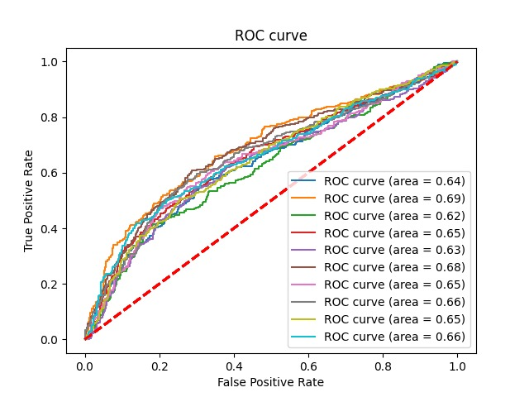
CROSS VALIDATION - original model (2)
KFOLD =10
test acc:
[0.8048484848484848, 0.8690909090909091, 0.8787878787878788, 0.8787878787878788, 0.88, 0.8666666666666667, 0.8895631067961165, 0.8640776699029126, 0.8689320388349514, 0.8434466019417476]
test auc:
[0.638366036892907, 0.6919404529526587, 0.6197021020453929, 0.6525124889803116, 0.6288272981487382, 0.6806407995296885, 0.6457821385426794, 0.661058187966514, 0.6478834232917718, 0.6571428571428571]

Slide 36
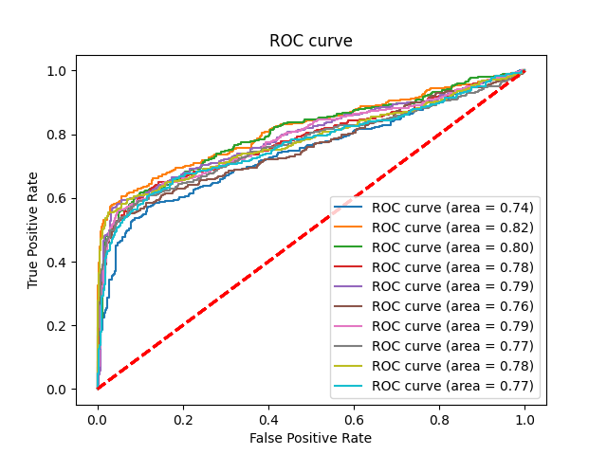
CROSS VALIDATION - 1 layer model
KFOLD =10
test acc:
[0.7781818181818182, 0.8484848484848485, 0.84, 0.8521212121212122, 0.8569696969696969, 0.8436363636363636, 0.875, 0.8531553398058253, 0.845873786407767, 0.8470873786407767]
test auc:
[0.7447535182289523, 0.816213061012712, 0.8039231827643385, 0.7814277989373206, 0.7941093457834016, 0.7593650457820562, 0.7869913705014089, 0.7713045019496632, 0.7829458734788886, 0.7697643801325988]

Slide 37
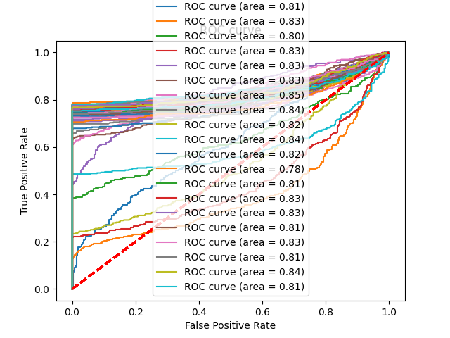
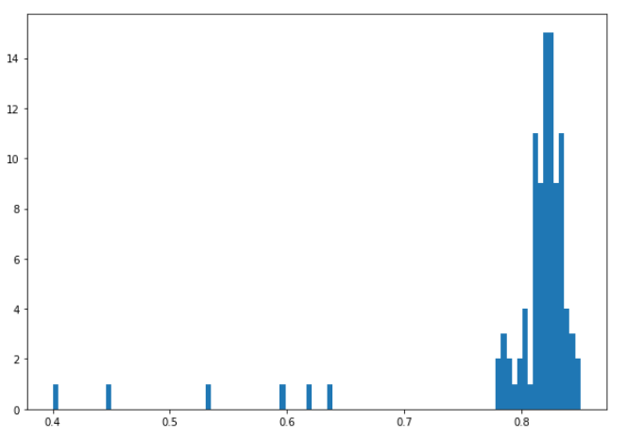
Monte Carlo approach on 1 layer reduced model
Avg Test ACC: 0.99509090909091
Avg Test AUC: 0.80331029128835
Time taken: 92 minutes

Slide 38
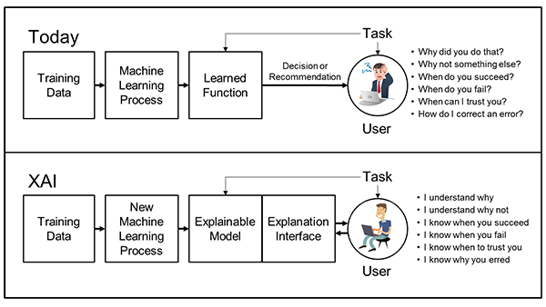
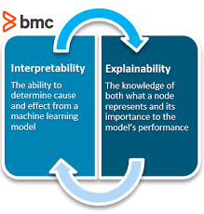
What is Explainable AI ?
Explainable Artificial Intelligence (darpa.mil)
Interpretability vs Explainability: The Black Box of Machine Learning – BMC Software | Blogs

Slide 39
Interpretability
Aim is to present some of the properties of a model in understandable terms to a human
If a model has high interpretability or explainability:
we understand how the model makes a prediction
how we can influence this prediction by changing input features.
We need to understand the output and WHAT caused the output

Slide 40
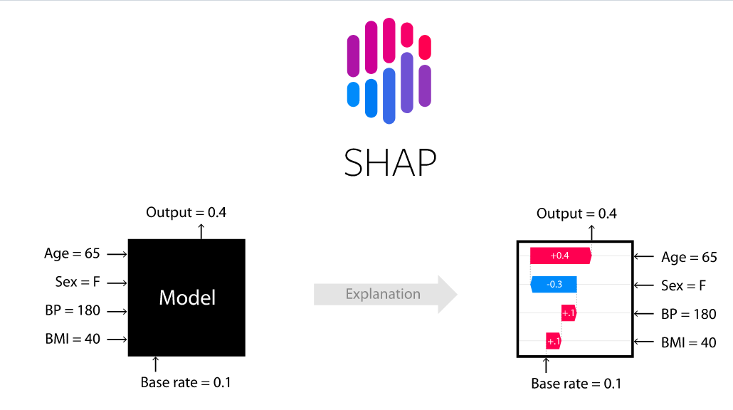
DeepSHAP

Slide 41
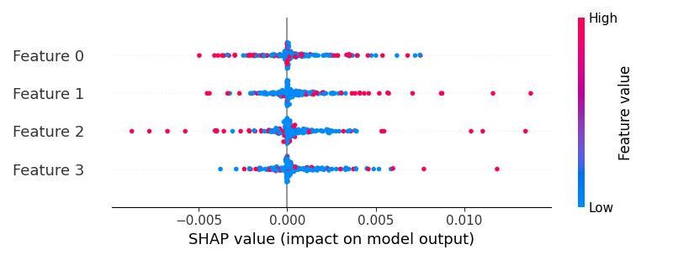
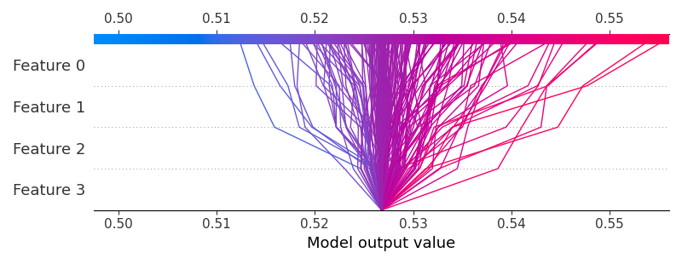
XAI Implementation Results
Summary plot
Decision plot

Slide 42
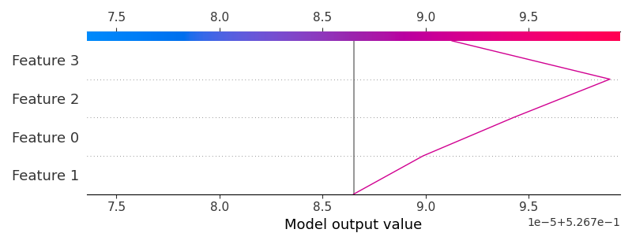
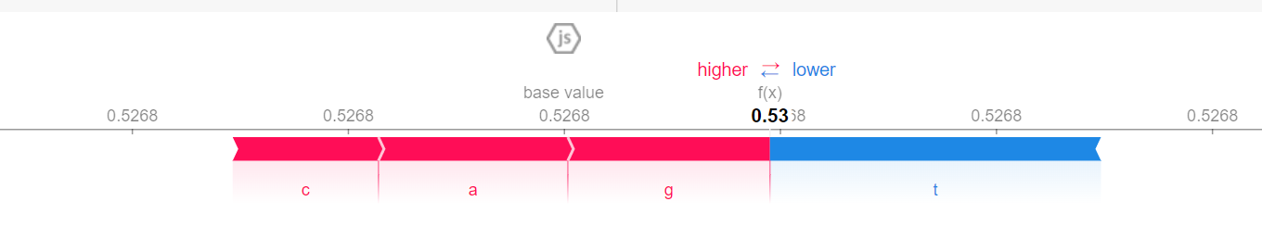
XAI Implementation Results
XAI decision plot for 1 sequence
XAI individual force plot

Slide 43
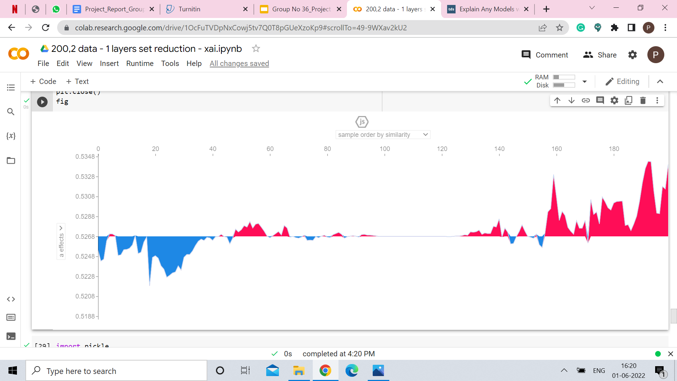
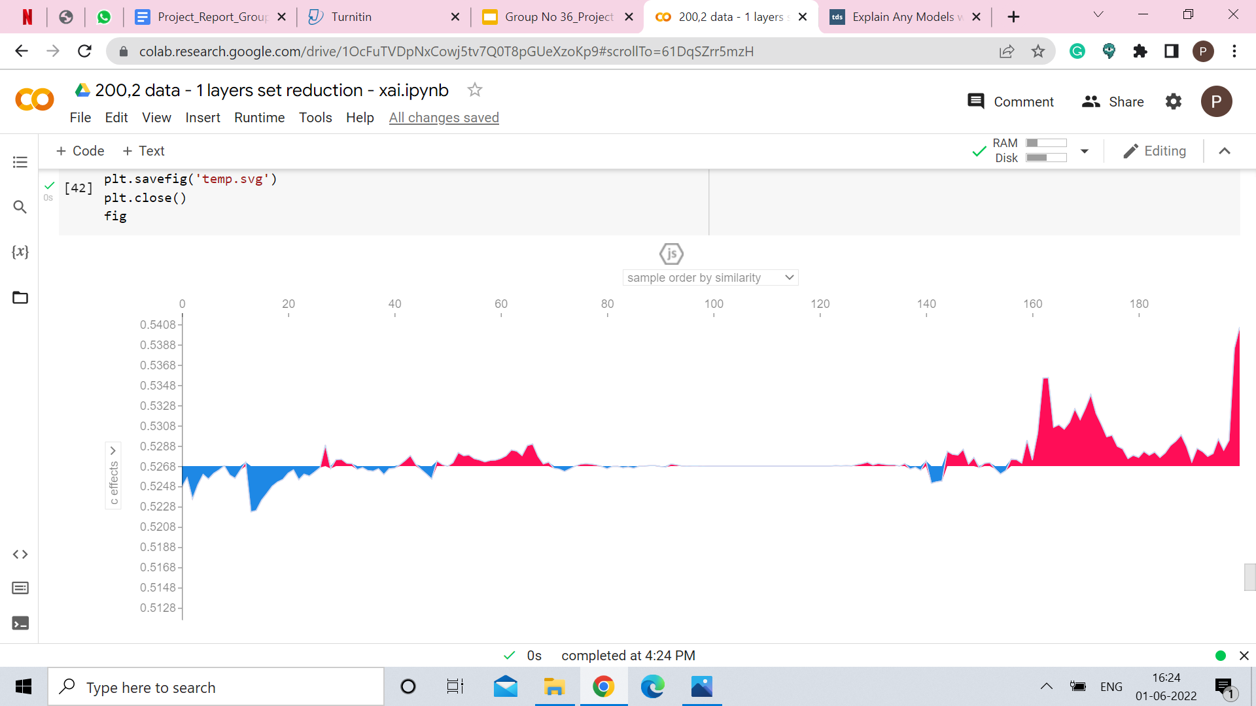
XAI Implementation Results
Effect of A
Effect of C

Slide 44
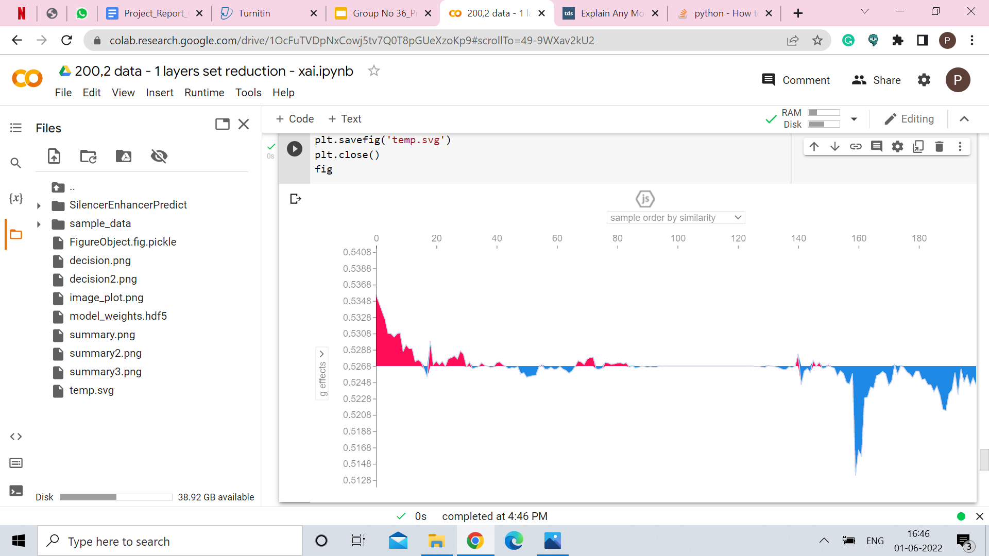
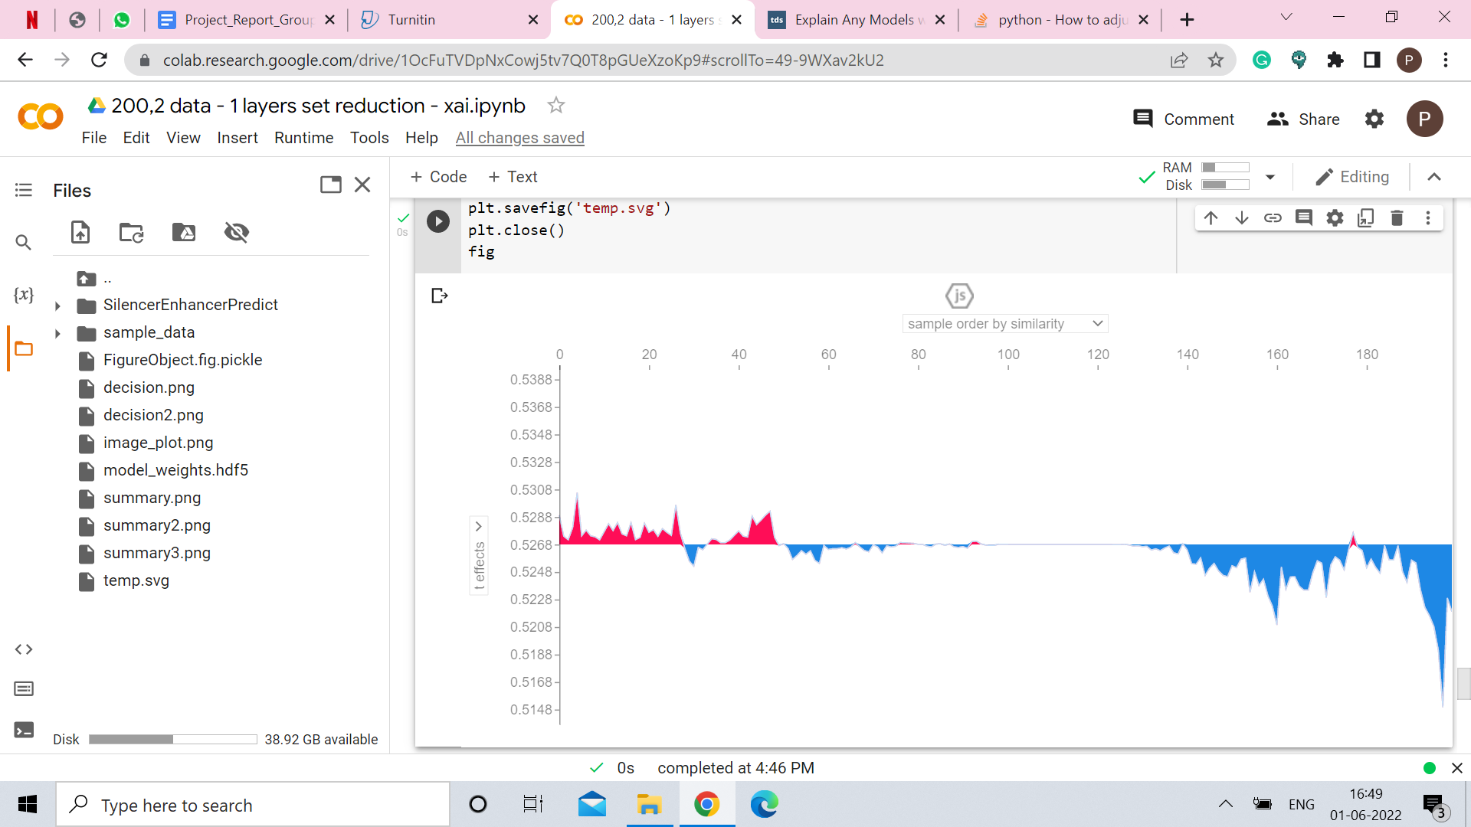
XAI Implementation Results
Effect of G
Effect of T

Slide 45
Future Work
Since, it’s expensive, time consuming and not easy to generate high throughput data, we wish to build a generative model that will generate its own data and feed it to the model.

Slide 46
Conclusion
Deep learning models have outperformed traditional statistical models in extracting features from the genome sequences
Computationally faster to execute
This generic pipeline can be open-sourced and useful for multiple uses under the domain of precision medicine

Slide 47
Accomplishments :
Participated in SWE Local Chapter ( Jan 2022 ).
Participated in Tech Srujan ( April 2022 ).
Participating in Kedar Tumne for Computer Department ( Present day ).
Will be presenting our work and findings at Dr. Narlikar’s Lab meeting in a month

Slide 48
References
https://genome.cshlp.org/content/early/2022/02/01/gr.275992.121.full.pdf
https://genome.cshlp.org/content/32/3/437.full
https://link.springer.com/article/10.1007/s12539-021-00453-4
https://en.wikipedia.org/wiki/Topologically_associating_domain
https://www.ncbi.nlm.nih.gov/pmc/articles/PMC8142020/
https://pubmed.ncbi.nlm.nih.gov/29654311/
https://www.biorxiv.org/content/10.1101/2020.09.03.282186v3
https://www.ncbi.nlm.nih.gov/pmc/articles/PMC4838359/
https://www.nature.com/articles/nature11082
https://arxiv.org/abs/1605.01133v2
https://github.com/QData/DeepMotif
https://paperswithcode.com/paper/deep-motif-visualizing-genomic-sequence
https://academic.oup.com/nar/article-lookup/doi/10.1093/nar/gkaa530#supplementary-data
https://www.nature.com/articles/s41467-017-02526-9

Slide 49
References
Methods for mapping 3D chromosome architecture: theory https://www.nature.com/articles/s41576-019-0195-2
3C and 3C-based techniques: the powerful tools for spatial genome organization deciphering: method https://molecularcytogenetics.biomedcentral.com/articles/10.1186/s13039-018-0368-2
A decade of 3C technologies: insights into nuclear organization: theory http://genesdev.cshlp.org/content/26/1/11.full
Comparative Hi-C Reveals that CTCF Underlies Evolution of Chromosomal Domain Architecture: method https://www.sciencedirect.com/science/article/pii/S2211124715001126#app1

Slide 50
Thank you

